Slide 1
Decontamination And Cleaning

Slide 2
Decontamination:
The removal of all visible and non-visible soil
And any other foreign material from the medical
Devices being reprocessed.

Slide 3
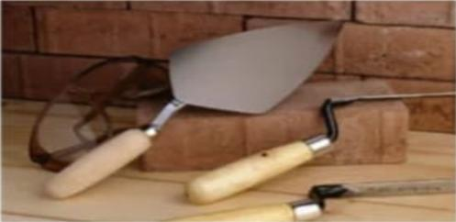
Importance of cleaning
Cleaning is the foundation of disinfection
Sterilization.

Slide 4
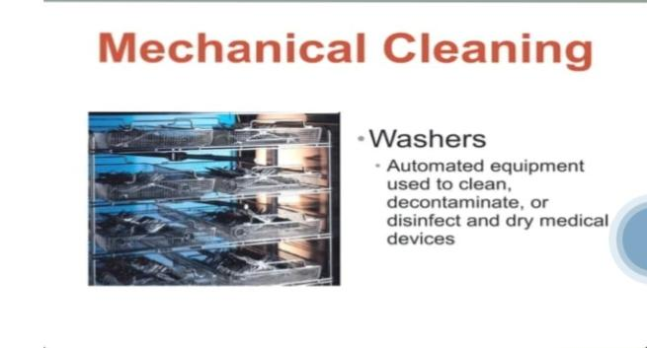

Slide 5
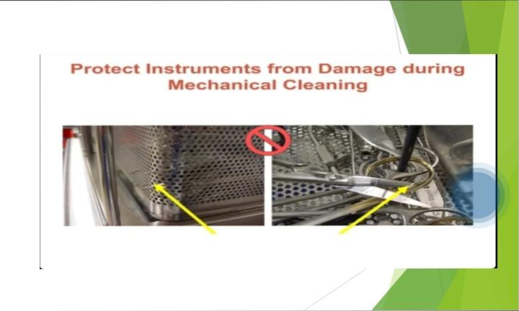

Slide 6
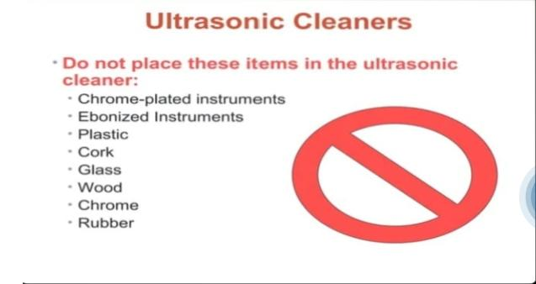

Slide 7
Decontamination
Removing or reducing contamination by
Infectious organisms or other harmful substances.

Slide 8
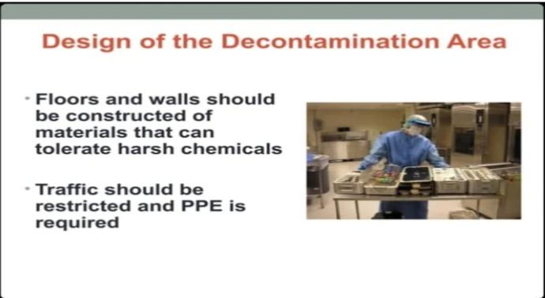

Slide 9
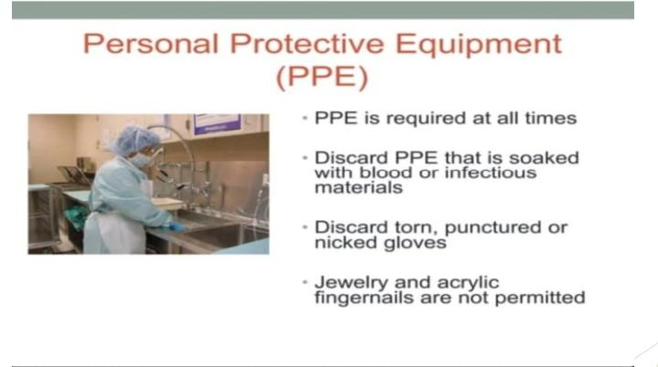

Slide 10
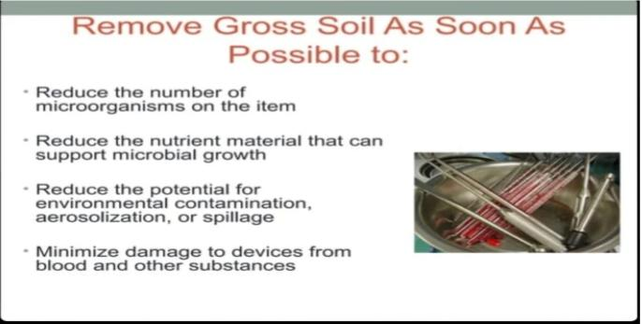

Slide 11
Package And Sterilization
of instruments and
equipments

Slide 12
Sterilization
Process capable of removing all viable form
Forms of microbial life including bectarial spores.

Slide 13
Methods of sterilization
Thermal sterilization
Moist heat
Dry heat
Chemical sterilization
Ethylene oxide gas
Paracetic acid
Radiation sterilization
Microwave
X- rays

Slide 14
Packaging
After sterilization instruments are put in to a
Closed container or wrapped individually.
Packaging material
Woven Fabrics
Non woven fabrics
Peel packs or pouches
Sealants and labeling
Count sheets

Slide 15
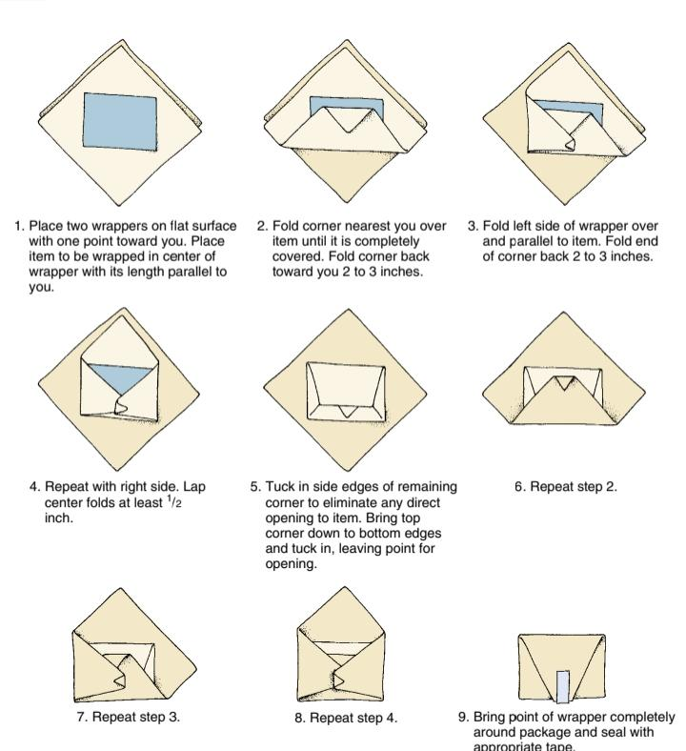
Methods of packaging

Slide 16
